Slide 1
Energy!

Slide 2
1) What is energy? What does it deal with? 2) Something or Someone with energy. What does it look like vs. something that doesn’t?

Slide 3
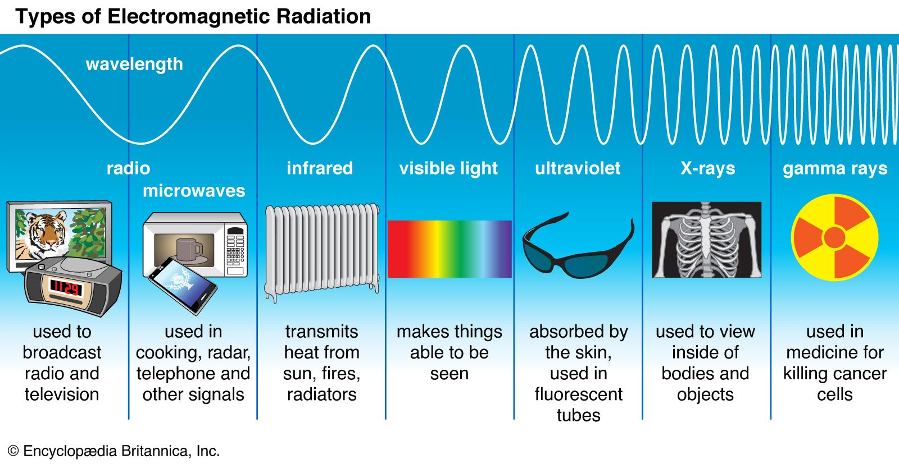

Slide 5
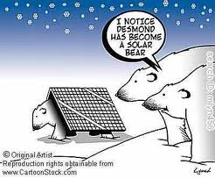
Energy!
Energy is the ability to do work, and ability to cause motion
SI Unit = Joules (J)
1 Joule = 1 N * 1 m
1 Joule = (1 kg * m/s²) * 1m
1 Joule = 1 kg * m²/s²

Slide 6
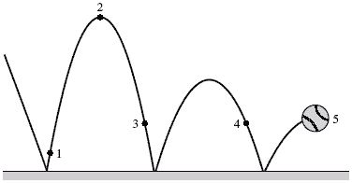
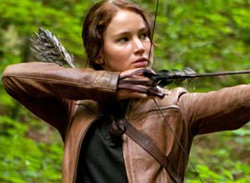
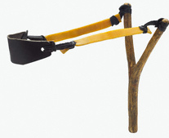
Potential Energy
Energy stored due to position or shape. It has the ability or “potential” to move.
There are 2 types:
1) Elastic – energy stored by things that stretch (or compress).
Examples? - Rubber bands, sling shots, elastic,
muscles, a spring, a ball bouncing, etc…

Slide 7
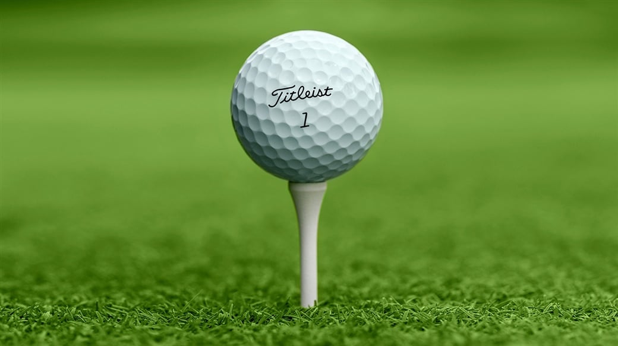
Elastic Potential Energy
Much of the “pop” of a golf ball off of a drive is the amount of compression within the impact. The golf ball wants to return to its normal shape…

Slide 8
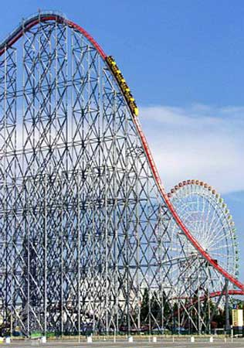
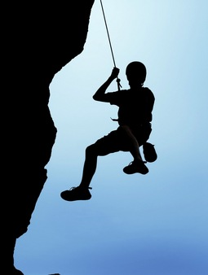
Potential Energy
2) Gravitational Potential Energy- energy stored by objects that are lifted off the ground.
GPE= mass * gravity * height
A 65kg rock climber ascends a cliff. What is the climber’s GPE at a point 35m above the base of the cliff?
GPE = m * g * h
GPE = 65kg * 9.8m/s² * 35m
GPE = 22295 joules

Slide 9
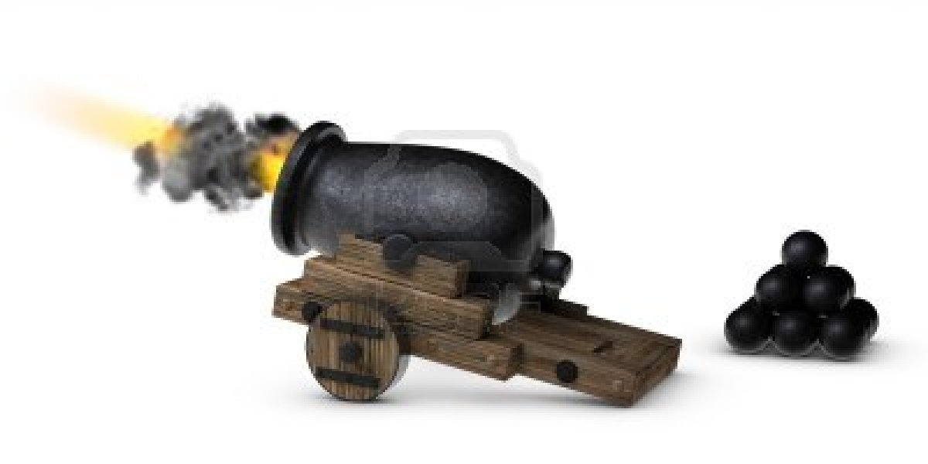
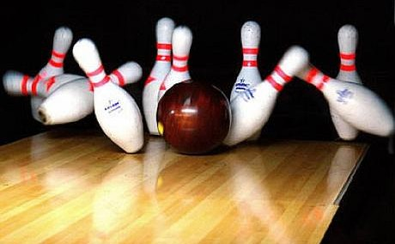
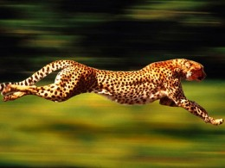
Kinetic Energy
Kinetic – energy of motion. Amount of energy depends on objects mass and velocity.
Formula
KE = ½ m * v²
Units = Joules

Slide 10
Kinetic Energy
Formula
KE = ½ m * v²
Units = Joules (remember 1J = 1N * 1m/s)
Practice: What is the Kinetic Energy of a 44kg cheetah running at 31m/s?
KE = ½ m * v²
KE = ½ (44 kg) * (31m/s)²
KE = ½ (44 kg) * 916m²/s²
KE = 21,142 joules

Slide 11
Practice Questions
Potential Energy= m x g x h
Kinetic energy= .5m x v²
1) A 70kg rock climber name Nolan Mandelkow ascends a cliff. What is the climber’s GPE at a point 50m above the base of the cliff?
2) Nolan found a certain girl extremely attractive and started chasing after her. What is the Kinetic Energy of a 40kg Nolan Mandelkow running at 31m/s?
3) Nolan Mandelkow once climbed to the top of Barn’s Bluff and was so tired he stopped talking….well not the stopped talking part. He was a 350m above the Mississippi and at that time weighed 100kg. How much energy does he possess?

Slide 12
The 7 Types of Energy!
Mechanical Energy
Chemical Energy
Electrical Energy
Nuclear Energy
Thermal Energy
Radiant Energy
Sound Energy

Slide 13
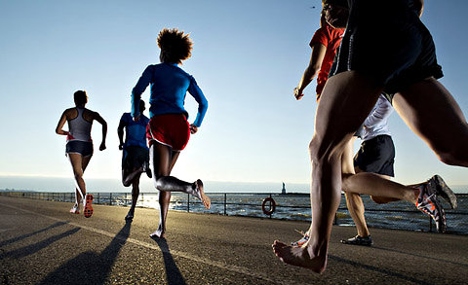
The 7 Types of Energy!
Mechanical Energy – the energy stored in an object due to its motion or position.
Mech Kinetic Energy: a moving car, a cheetah running
Mech Potential Energy: stored in a spring, compressed ball, or a plane in the air
Examples:
A running kid, a flying plane, a potted plant sitting on a ledge

Slide 14
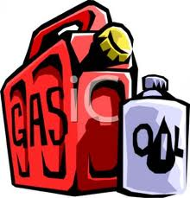
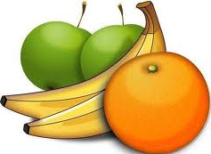
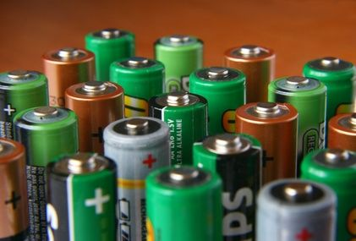
The 7 Types of Energy!
2) Chemical Energy – Energy stored in the bonds that hold them together.
Chem Potential Energy: stored in a battery or ethanol
This energy changes into another form during chemical reactions.
Examples:
Food, batteries, humans, gasoline, trees, etc.

Slide 15
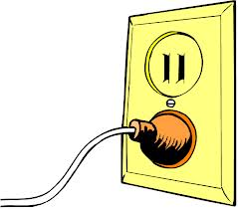
The 7 Types of Energy!
3) Electrical Energy – Energy of electrons
moving around a circuit.
Elec Kinetic Energy: movement of electrons
Elec Potential Energy: stored in a capacitor
Examples: Batteries in cell phone, car batteries,
lamp plugged into outlet.
4) Nuclear Energy – Energy stored within the nucleus
Examples: nuclear fission (nucleus splitting) at a nuclear power plant to provide electricity to a city, uncontrolled fission of a nuclear bomb, nuclear fusion (nucleus joining) in the sun

Slide 16
The 7 Types of Energy!
5) Thermal Energy – type of energy that comes from heat and the movement or particles
Examples: The sun, a grill, stove,
6) Light Energy – energy associated with electromagnetic spectrum and light waves.
Examples: radio waves, visible light, microwaves, X-rays
7) Sound Energy – A form of mechanical energy that is produced when objects vibrate and travel through air, water, wood or metal.

Slide 17
Law of Conservation of Energy
Energy can never be created or destroyed. Energy can only change from one form to another.
Net Energy is the total amount of energy in a system.
The total or net amount of energy must stay the same when energy changes forms.

Slide 18
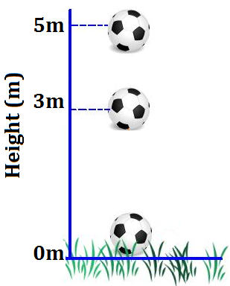
Law of Conservation of Energy
Before the drop
If the 4kg soccer ball is held at a height of 5m, how much GPE does it have?
GPE = M * G * H = 196 joules of GPE
Because the ball is above the ground.
If the 4kg soccer ball is held at a height of 5m, how much KE does it have?
KE = ½ mv² = 0 joules of KE
Because the ball not moving

Slide 19
Law of Conservation of Energy
After the drop…
If the 4kg soccer ball is dropped, how much GPE does it have when it strikes the ground at 0m?
GPE = M * G * H = 0 joules of GPE
Because the height is 0m
If the 4kg soccer ball is dropped, how much GPE does it have when it strikes the ground at 0m?
KE = ½ mv² = 196 joules of KE
Because the ball is moving as it’s fastest speed.

Slide 20
Law of Conservation of Energy
Recap:
So for an object that is going to simply “fall”
GPE at the Drop Point = KE at the Impact Point
Because all of the GPE is converted to KE throughout the fall
This only works for “falling” objects though….
A roller coaster is not falling, per se…

Slide 21
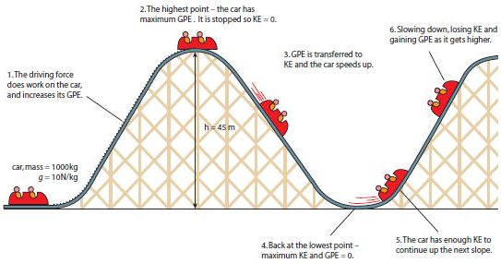
But a Roller Coaster is not just a fall…
As we start at the top of the 1st hill…

Slide 22
Energy Changes on the Roller Coaster
We saw on previous slide that the GPE the car has at the top of the 1st hill will turn into KE as the car travels down the hill.
And that the KE the car has at the bottom of the 1st hill will turn into GPE as the car travels up the next hill.
But is this a perfect
transformation of
energy from
GPE to KE
and back?
Nope.
Energy is lost as heat and sound.

Slide 23
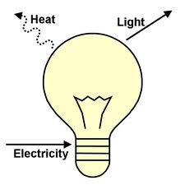
Energy Conversions
A Lightbulb
Start with __Electricity_ → End with ___Light__ Waste __Heat___
Can you determine the other 4 energy conversions? Remember: Law of Conservation of Energy…
A fan
Start with __________ End with _________ Waste ________
A battery
Start with __________ End with _________ Waste ________
A fire
Start with __________ End with _________ Waste ________
A glowstick
Start with __________ End with _________ Waste ________

Slide 24
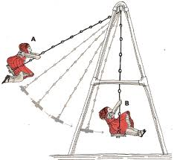
Energy Conversion Example:
As a swing moves back and forth, the energy is converting from one form to another…..
Why will the swing eventually stop?
In what form will that energy be transferred into?

Slide 25
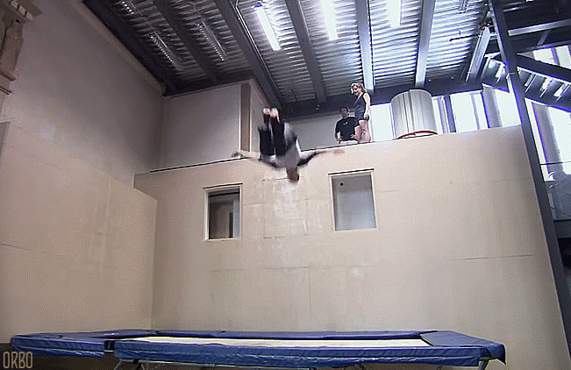
Explain this conversion of energy
Using the words gravitational potential energy, elastic potential energy, kinetic energy, and gravity…
You should also
be able to discuss
Newton’s 3 Laws…

Slide 26
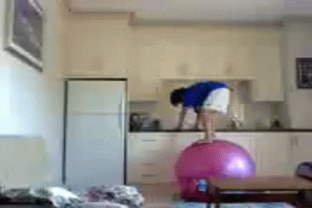
Explain this conversion of energy
Using the words gravitational potential energy, elastic potential energy, kinetic energy, and gravity…
You should also
be able to discuss
Newton’s 3 Laws…

Slide 27
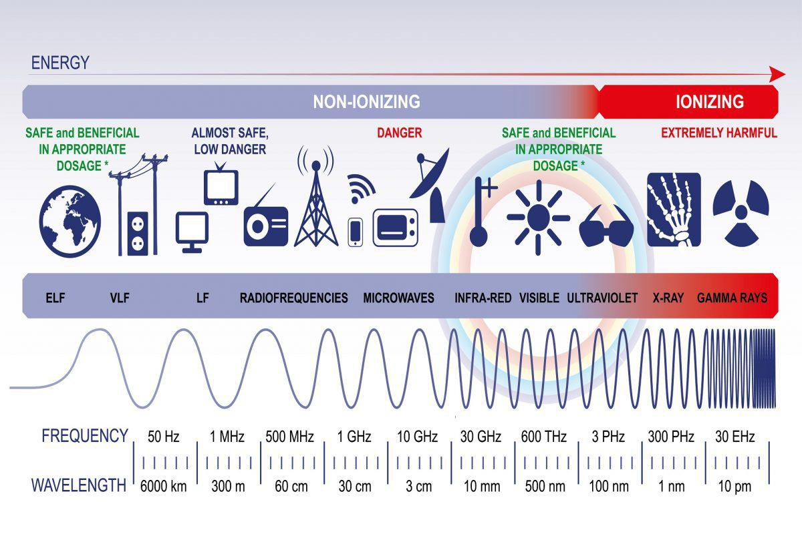

Slide 28
The Electromagnetic Spectrum
Notes:
Presentation for lesson 4: Exploring the Electromagnetic Spectrum, in the Waves: The Three Color Mystery unit
The slides are animated so you can click (space bar, mouse, etc.) to show the next item when the class is ready.

Slide 29
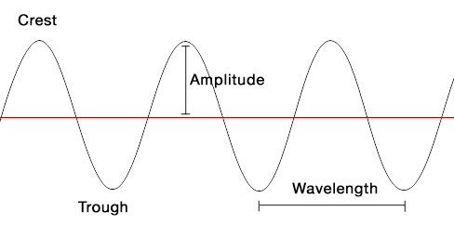

Slide 30
Things to Remember
The higher the frequency, the more energy the wave has.
EM waves do not require media in which to travel or move.
EM waves are considered to be transverse waves because they are made of vibrating electric and magnetic fields at right angles to each other, and to the direction the waves are traveling.
Inverse relationship between wave size and frequency: as wavelengths get smaller, frequencies get higher.
Notes:
Play an interactive tutorial to explore the classical representation of an electromagnetic wave as a sine function; you can vary amplitude and wavelength to demonstrate how this function appears in three dimensions. (requires java plug-in) See: http://micro.magnet.fsu.edu/primer/java/electromagnetic/index.html

Slide 31
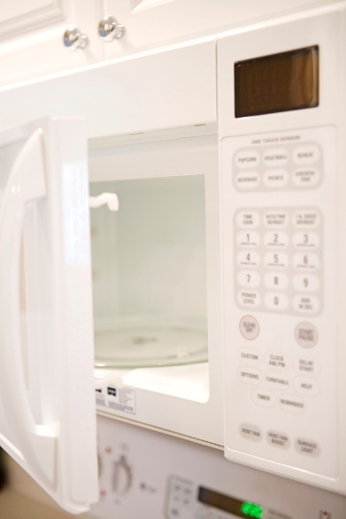
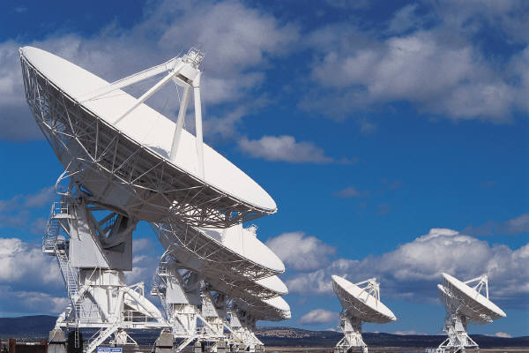
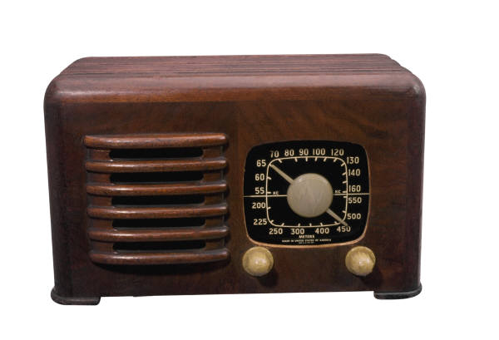
The Waves (in order…)
Radio waves: Have the longest wavelengths and the lowest frequencies; wavelengths range from 1000s of meters to .001 m
Shortest are the microwaves
Used for: RADAR, cooking food, satellite transmissions

Slide 32
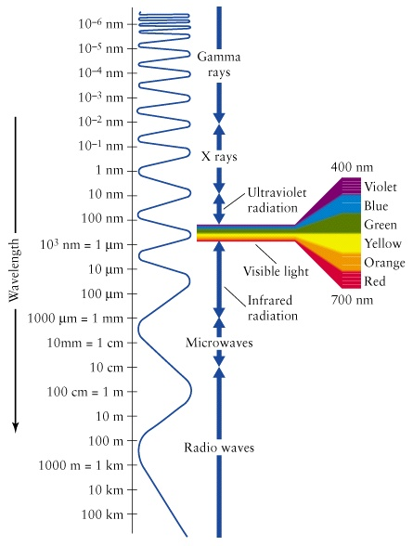
Infrared waves (heat): Have a shorter wavelength, from .001 m to 700 nm, and therefore, a higher frequency.
Used for finding people in the dark and in TV remote control devices
Visible light is what we can SEE in the EM spectrum. Wavelengths range from 700 nm (red light) to 400 nm (violet light) with frequencies higher than infrared waves.
Visible light waves are a very small part of the EM spectrum!

Slide 33
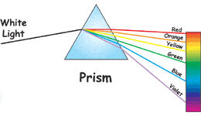
Visible Light Remembering the Order
ROY G. BIV
red
orange
yellow
green
blue
indigo
violet
Notes:
Light from the sun looks white, but it is really made up of all the colors of the rainbow. A prism is a specially shaped crystal. When white light shines through a prism, the light is separated into all its colors.

Slide 34
Ultraviolet Light: Wavelengths range from 400 nm to 10 nm; the frequency (and therefore the energy) is high enough with UV rays to penetrate living cells and cause them damage.
Too much UV can lead to sunburn and skin cancer. However, we use UV to produce vitamin D in our bodies. UV rays are easily stopped by clothing.
Used for sterilization because they kill bacteria.
Although we cannot see UV light, bees, butterflies, and birds can (along with bats and small rodents).

Slide 35
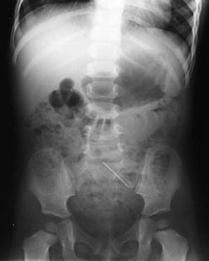
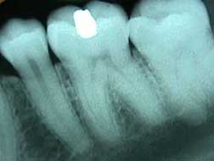
X-Rays: Wavelengths from 10 nm to .001 nm. These rays have enough energy to penetrate deep into tissues and cause damage to cells but are stopped by dense materials, such as bone.
Used for looking at solid structures, such as bones and bridges (for cracks), and for treatment of cancer.

Slide 36
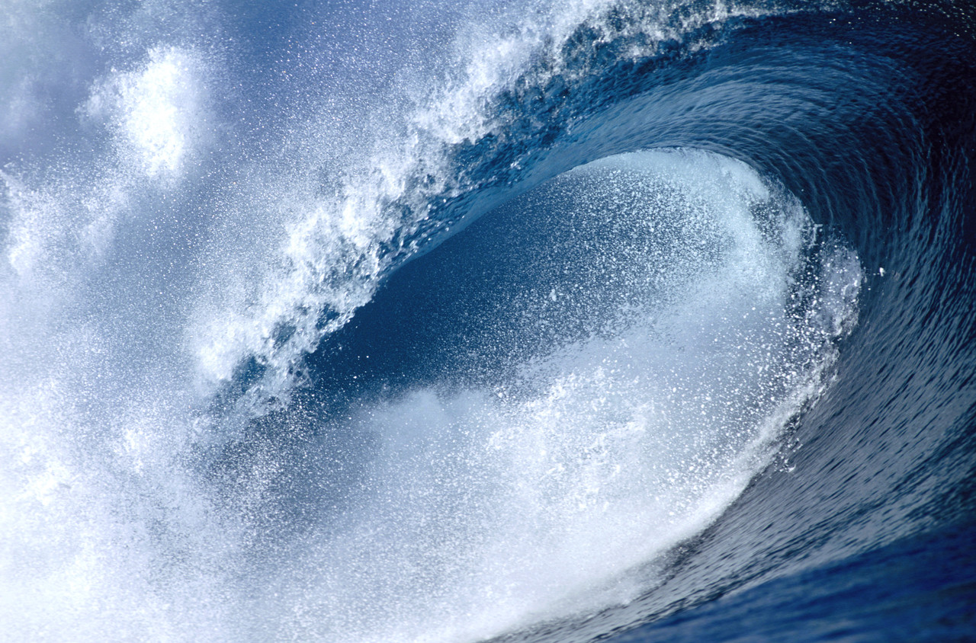
Waves and Wave Properties
Notes:
Presentation for lesson 2: Waves and Wave Properties, in the Waves: The Three Color Mystery unit
The slides are animated so you can click (space bar, mouse, etc.) to show the next item when the class is ready.

Slide 37
If waves have a medium, it is called a mechanical wave.
If waves can travel without a medium (such as space), it is called an electromagnetic wave (or EM wave).

Slide 38
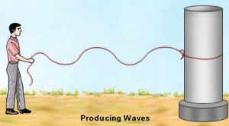
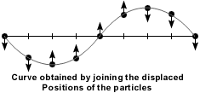
Wave Types
Transverse waves: Waves in which the medium moves at right angles to the direction of the wave

Slide 40
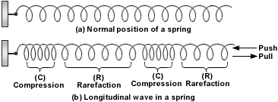
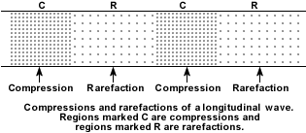
2. Compressional (or longitudinal) waves: Waves in which the medium moves back and forth in the same direction as the wave

Slide 41
